Slide 1
Lecture 10a More complex graphics
Kristin Privitera-Johnson
FISH 552 Introduction to R

Slide 2
Aims
To explore more of the options in R contained in par
Create more informative plots
Layouts for multiple plots
Boxplots
Barplots

Slide 3
Possum data
Possum data come from the DAAG package
Download from Canvas: Data files\possum.csv
> possum <- read.csv(file="Data\\possum.csv")
> head(possum,n=3)
X case site Pop sex age hdlngth skullw totlngth
1 C3 1 1 Vic m 8 94.1 60.4 89.0
2 C5 2 1 Vic f 6 92.5 57.6 91.5
3 C10 3 1 Vic f 6 94.0 60.0 95.5
taill footlgth earconch eye chest belly
1 36.0 74.5 54.5 15.2 28.0 36
2 36.5 72.5 51.2 16.0 28.5 33
3 39.0 75.4 51.9 15.5 30.0 34

Slide 4
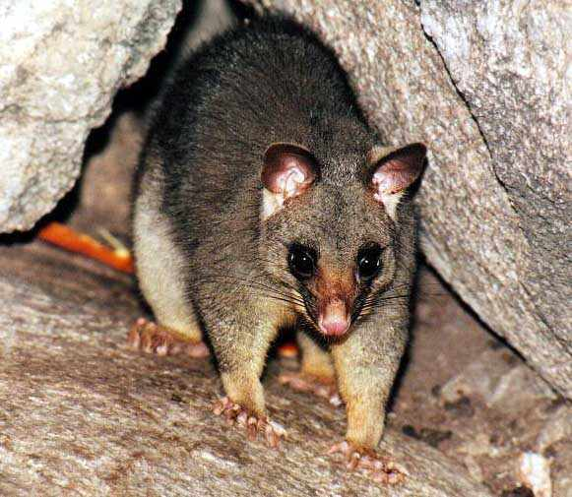
Possum data
case: observation number
site: one of seven locations where possums were trapped
Pop: a factor which classifies the sites as Vic Victoria, other New South Wales or Queensland
sex: a factor with levels f female, m male
age: age
hdlngth: head length
skullw: skull width
totlngth: total length
taill: tail length
footlgth: foot length
earconch: ear conch length
eye: distance from medial canthus to
lateral canthus of right eye
chest: chest girth (in cm)
belly: belly girth (in cm)
http://www.richard-seaman.com/Mammals/Australia/

Slide 5
Multiple graphs
It is often very useful to plot multiple graphs together
Simple way: create a matrix of plots using par(mfrow=c(nr, nc)) or par(mfcol=c(nr, nc))
Require a vector of the number of rows and number of colums: c(nr, nc)
To fill by row use mfrow
To fill by column use mfcol
Must specify the par(mfrow=c(nr, nc)) command before making the plots

Slide 6
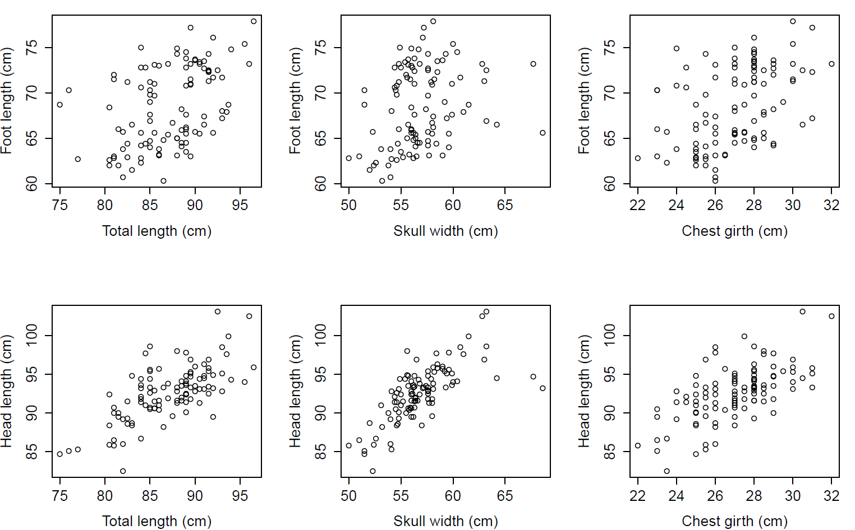
par(mfcol=c(2,3))

Slide 7

Edward Tufte’s rules
Maximize the data:ink ratio
Erase non-data ink
Increase the data density
Label the figures, avoid using legends
Tufte ER (2001) The visual display of quantitative information. 2nd ed. Graphics Press, Cheshire, Connecticut

Slide 8
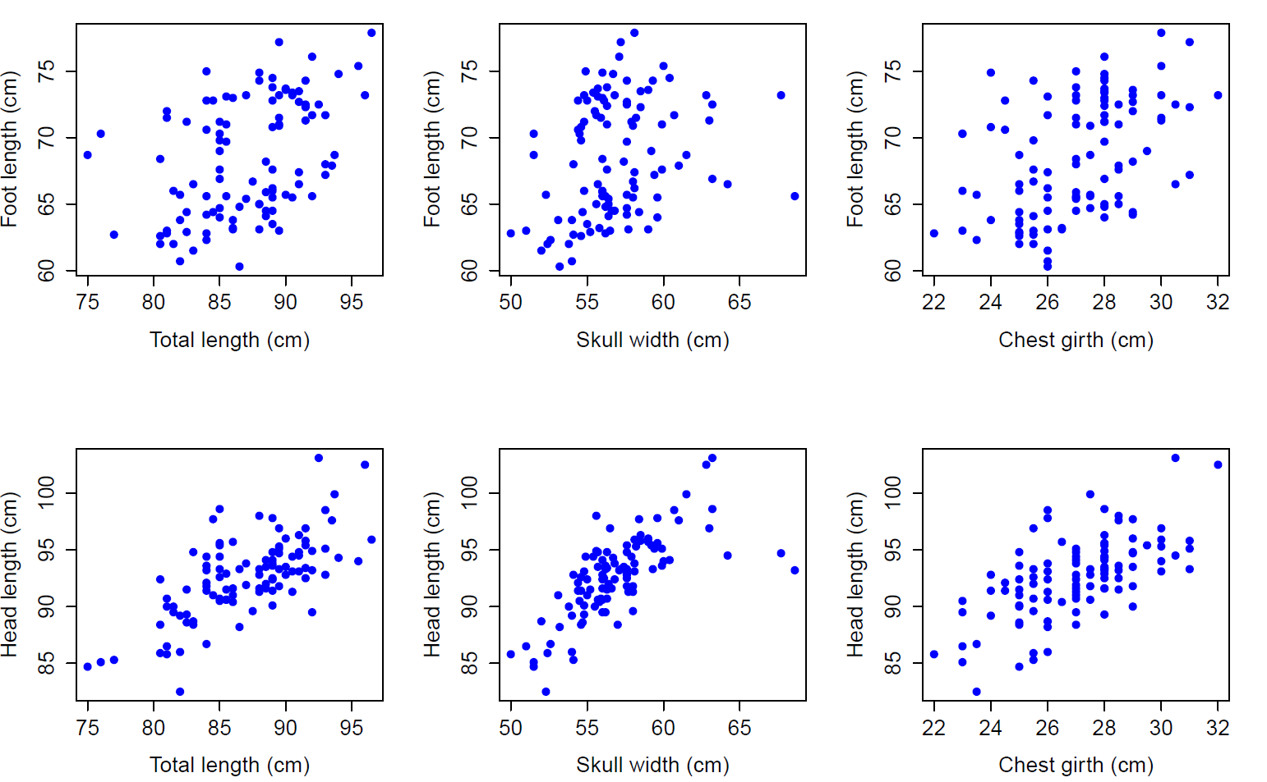
Data-ink is in blue

Slide 9
Redundant parts and wasted space

Slide 10
Changing the margins
When multiple plots are laid out, space can be optimized by modifying margins around each plot
par(mar = c(bottom, left, top, right))
Default is par(mar = c(5,4,4,2) + 0.1)
To change the margins around the entire figure, use this command:
par(oma = c(bottom, left, top, right))
Default is par(oma = c(0,0,0,0))

Slide 11
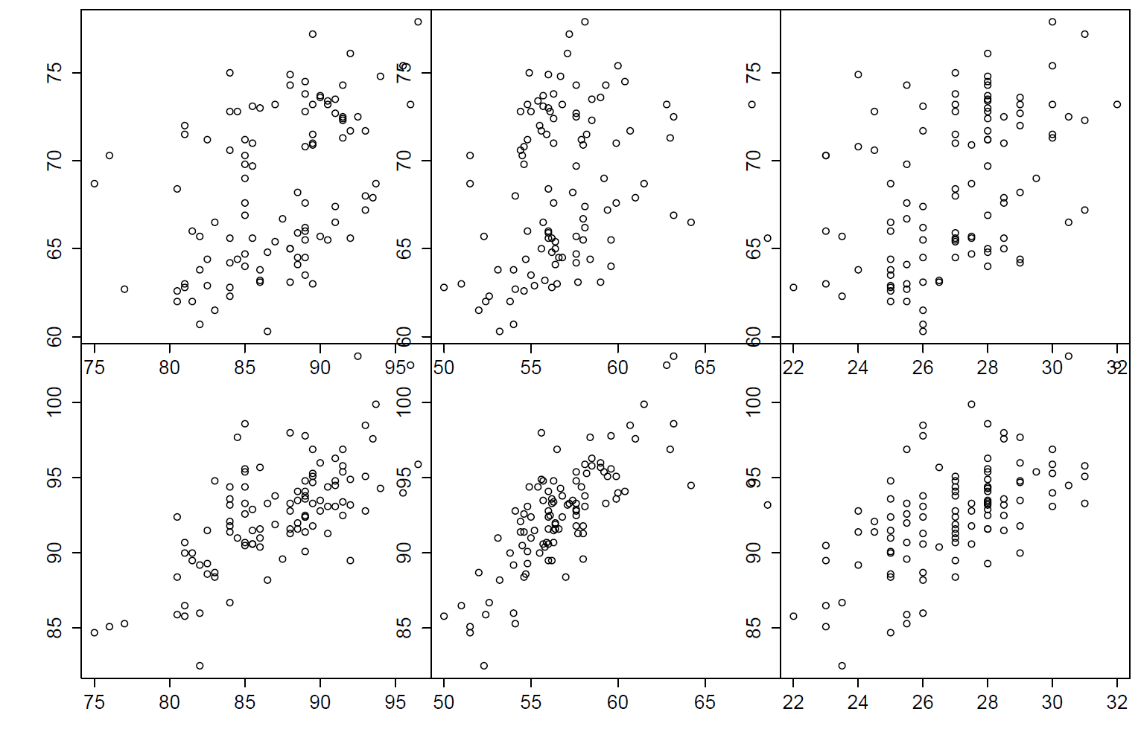
par(mar=c(0,0,0,0), oma=c(5,5,1,1))

Slide 12
Deleting axes, adding labels
To eliminate x or y axes or both, add to each individual plot
plot(..., xaxt="n", yaxt="n")
To add text to the outside of an individual plot, use a standalone command mtext after a single plot
mtext(text="Foot length (cm)", side=2, line=3)
To add text to the outside of multiple figures, use mtext with the outer=T option
mtext(text="Year", side=1, line=3, outer=T)
Values for side of the plot refer to 1=bottom, 2=left, 3=top, 4=right

Slide 13
Hands-on exercise 1 (starting code)
possum <- read.csv(file="possum.csv")
par(mfcol=c(2,3))
plot(possum$totlngth, possum$footlgth)
plot(possum$totlngth, possum$hdlngth)
plot(possum$skullw, possum$footlgth)
plot(possum$skullw, possum$hdlngth)
plot(possum$chest, possum$footlgth)
plot(possum$chest, possum$hdlngth)

